Slide 1



Identification of Higgs Boson!!

Slide 2


INSTITUTES FOR ADVANCED COMPUTING AND
SOFTWARE DEVELOPMENT
AKRUDI, PUNE
PRESENTATION ON
“Identification of Higgs Boson particle by Machine Learning Approach”
PG-DBDA Feb-2020”
Submitted By:
Yogesh Mundra (1329)
Manoj Pawar (1334)

Slide 3
Content
Introduction.
Literature Review.
Problem Statement.
Objectives.
Proposed Work.
System Architecture.
Methodology and Implementation.
Applications.
Conclusion.

Slide 4
Introduction
The domains involved in our proposed Project are Machine Learning and Data Analytics, applied in Particle Physics.
The proposed project is based on the identification of the Higgs Boson sub-atomic particle from jet pull energy dataset of the particles’ decay, as modeled by the ATLAS Experiment in the Large Hadron Collider(LHC) at CERN.
Goal
In particle physics, Higgs Boson to tau-tau decay signals are notoriously difficult to identify due to the presence of severe background noise generated by other decaying particles. Our approach uses a collection of ML Algorithms to classify the events as signals and background noise.

Slide 5
Literature Review
G. Aad, 2012, The ATLAS Collaboration, proposed a Journal on “Observation of a new particle in the search for the Standard Model Higgs boson with the ATLAS detector at the LHC(Large Hadron Collider)”.
S. Chatrchyan et al., 2012, The CMS Collaboration, proposed a Journal on “Observation of a new boson at a mass of 125 GeV with the CMS(Compact Meoun Solenoid) experiment at the LHC.”

Slide 6
Problem Statement
Identification of the Higgs Boson Particle, with the capturing of Tau-Tau Particle from the CERN’s Dataset of the particles’ decay from the jet pull energy experimented by ATLAS in the Large Hadron Collider (LHC).

Slide 7
Objectives
To classify the events of the dataset into the Signal and background Noise.
To determine the Noise as background disturbance that contradicts the tau-tau decay.
To determine the Signal as ‘tau-tau decay’ to identify Higgs Boson (large particle) made up of tau leptons (smaller particles).
To use ensemble Machine Learning Algorithm to enhance Accuracy of the Signal and classifying it from the Noise.

Slide 8
Proposed Work
The solution for proposed problem statement is divided into the following modules:
1] Dataset – it consist of approx. 70000 events of the Jet-flow in LHC.
2] Data Cleaning – to clean the data by removing redundant features, if any and also create the derived features as per the existing features.
3] Data Visualization – to visualize the data on the relevant features by using Scatter Plot, Correlation Plot , Bar Charts.
4] Validation – evaluating the pre-processed data by the subset validation.
5] ML Model Building and Prediction – to evaluate different ML Algorithms on the training set and predicting the result from the test set. Finally, choosing the best result based on Accuracy and F1 Score of respective Algorithm.
6] Result – the result will contain the Accuracy, F1 Score and suitable Graph as a Pie Chart or a Bar Plot.

Slide 9
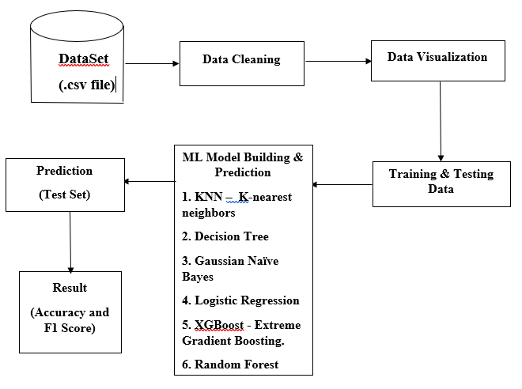
System Architecture

Slide 10
Methodology & Implementation
Further, we intend to use following ML Algorithms :
1] KNN – K-nearest neighbors
2] Decision Tree
3] Gaussian Naïve Bayes
4] Logistic Regression
5] XGBoost - Extreme Gradient Boosting.
6] Random Forest
As the data would be available by the ATLAS Experiment of CERN Laboratories, we will be analyzing the Data, i.e. performing all the concepts of the Data Analytics Paradigm.
Then, we will be using ML Approach, i.e. use the Machine Learning Algorithm to separate the Background(noise) from the Signals(intended Higgs-Boson particles)

Slide 11
The output will be the Graph, precisely a Pie-Chart that depicts the Elementary Particles in decay after the collision.
Input
Output
The input is the dataset provided by CERN, which is open sourced, so that the data scientists can appropriately verify the presence of certain Elementary Particles after the Proton-Proton collision by ATLAS Experiment in Large Hadron Collider at CERN.

Slide 12
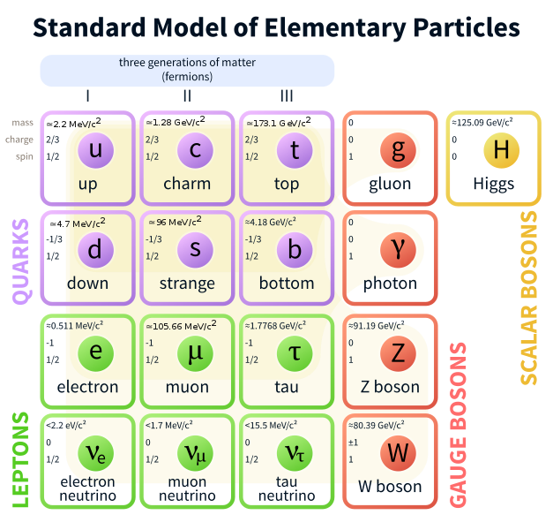
Terminologies
Elementary Particles
Standard Model
Fermions and Bosons
Quantum in
Higgs Field
Higgs Boson

Slide 13
Applications
Manufacturing :
By reducing the effect of the Higgs field on a metal with low mass metal working will be easier and the alloys formed can be more homogenous and of better quality.
By increasing the effect of the Higgs field, the mass of the metal can be increased allowing for high mass compaction of materials. Thus producing highly dense, stronger and more durable materials.
Transportation :
Transport of heavy construction equipment to remote locations would be both easier and speedier if the mass of the payload could be reduced.

Slide 14
Defence :
Explosive payloads could be transported to required sites at higher speeds and using lesser energy, if their mass could be reduced.
Low mass projectiles could be accelerated to higher speeds thus increasing their penetrative power seeking to cut through armor plates instead of striking against them

Slide 15

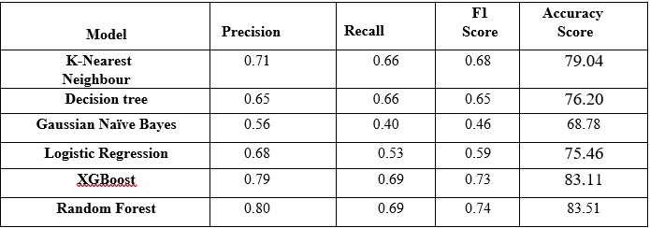
Conclusion
Our proposed solution to the Higgs Boson Identification problem can be successfully implemented using the ML Approach. Further, we intend to finalize the results based on the Algorithm with maximum efficiency, i.e. selection on the basis of high Accuracy and F1 score. It would result in attaining the maximum Tau-Tau particles (signals), that eventually verifies the existence of Higgs-Boson Particle.

Slide 16
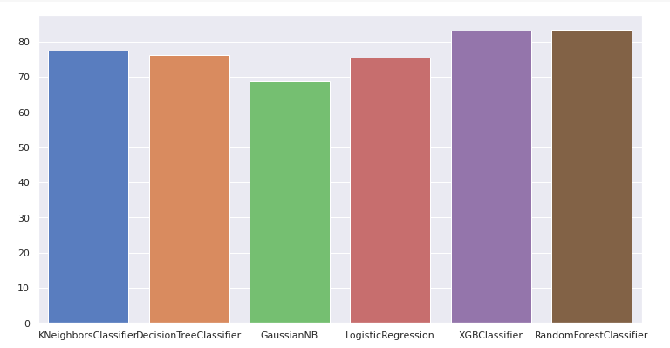






Comparison of all Machine Learning Models

Slide 17
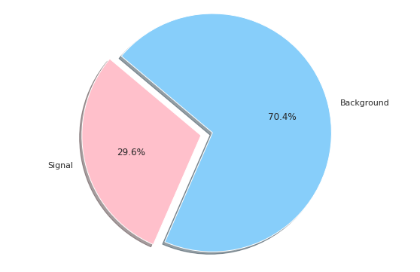
Prediction of Signal & Background Noise

Slide 18
Questions & Comments

